Slide 1

Moving from CA 2E to CA Plex or extend the existing 2E Apps with modern web-based applications
Axel Oberländer and James Ryan
eMail: axel.oberlaender@teamconsult.de
URL: www.teamconsult.de

Slide 2
Moving from CA 2E to CA Plex…
Why migrate ? (Migrating is positioning!)
  Enable state of the art technology for new business requirements
  Reduce maintenance
  Avoid supplier dependency
  (no one supplier can Solve All Problems)
  Keep stability while increasing flexibility
  Increase transparency
  Facilitate refactoring
  Fashion

Slide 3
Moving from CA 2E to CA Plex…
Why not migrate ?
  Cost
  Complacency
  Complexity
  Lots of work, no apparent advance
  FEAR !
  No need ?

Slide 4
Moving from CA 2E to CA Plex…
Possible approach to migration
  Be clear of your goals
  Clean up and preparation
  Possible refactoring
  Evolution or revolution
  Get the base (model) ready
  Functional migration
    Big bang
    Several small bangs
  Functional enhancement

Slide 5
Moving from CA 2E to CA Plex…
What is important when migrating?
  Painless
  Eradicate monotonous activities
  Eliminate the source of errors
  Functionality remains unchanged
  Speed
  Rigour
  Agile deployment of migrated functionality
Automation

Slide 6
Moving from CA 2E to CA Plex…
Automation
is essential when migrating
Without automation…
…you will never migrate and more importantly, will never be able to.

Slide 7
Moving from CA 2E to CA Plex…
Agenda:
Where do we all come from
A productivity tool for CA Plex
Demo
Demo
Demo

Slide 8
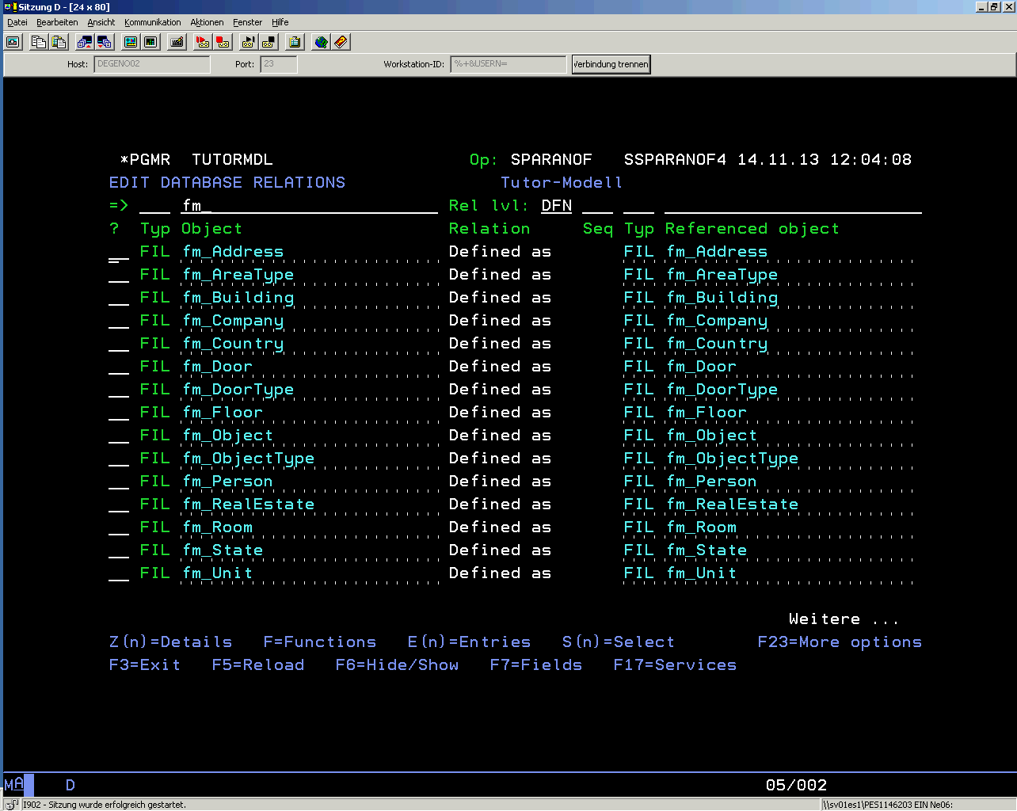
Moving from CA 2E to CA Plex…
Where do we all come from:

Slide 9
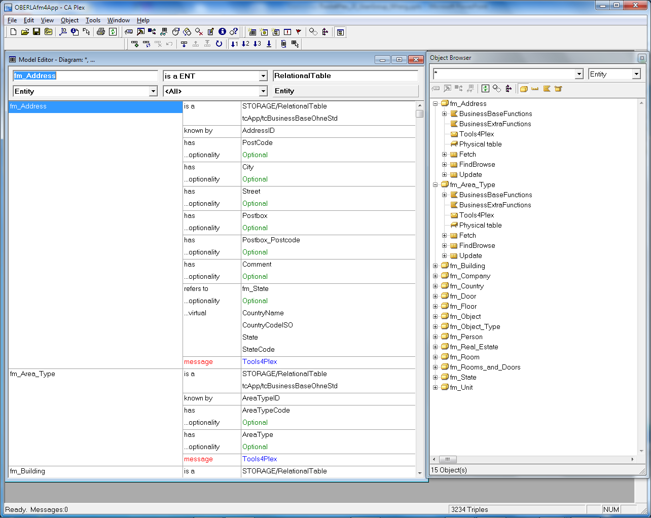
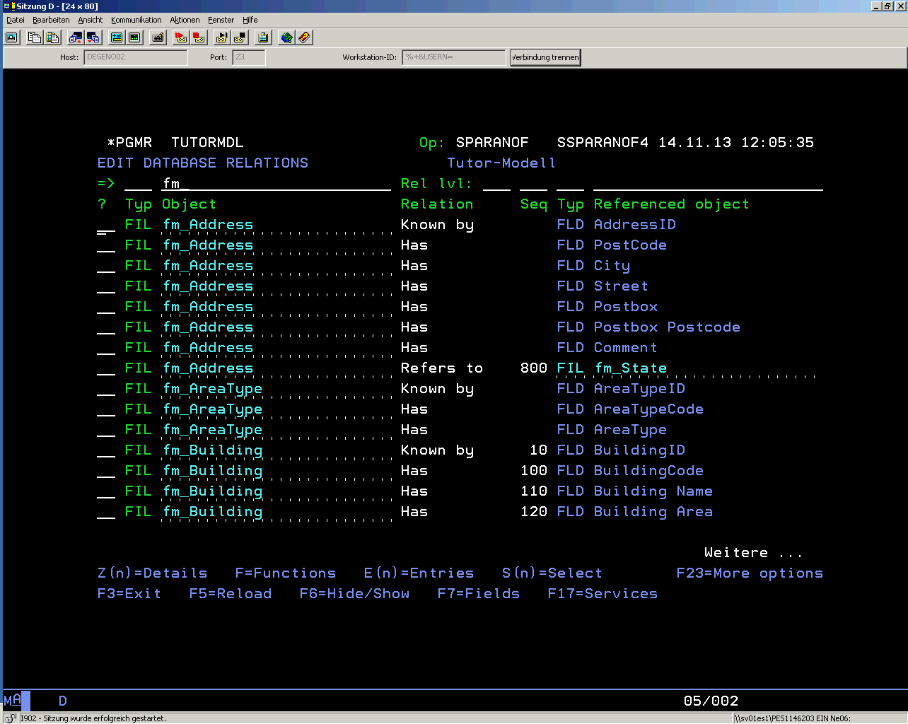
Moving from CA 2E to CA Plex…
Where do we all come from:

Slide 10
Moving from CA 2E to CA Plex…
Example in numbers
Textile industry - ERP/PPS system written in Synon
500 Entities
8.500 Fields
with 14.400 Labels
215.500 Values (with inherited values, absolute 33.500)
5.400 Attributes
18.500 ImplNames & FileNames (autonaming?)
400 Qualifier
490 Physical tables
1.470 Views
= 85.000 Object definitions

Slide 11
An example in numbers…
Example in numbers
Textile industry - ERP/PPS system written in Synon
= 85.000 Object definitions / triples / …
+ error correction
+ quality control
= how long do you think?
  With Tools4Plex in less than one day !
  Without the definitions necessary inside the tool to describe the naming rules, datatype mapping, etc. This means another 2-3 days.

Slide 12
Moving from CA 2E to CA Plex…
Agenda:
Where do we all come from
A productivity tool for CA Plex
Demo
Demo
Demo

Slide 13
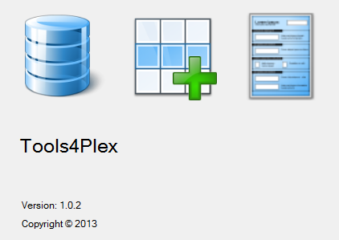
Moving from CA 2E to CA Plex…
Automation is right there with

Slide 14
Moving from CA 2E to CA Plex…
DEMOsss
Notes:
14

Slide 15
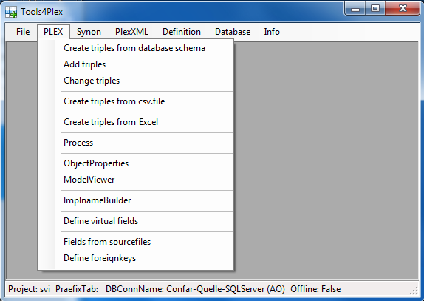
Moving from CA 2E to CA Plex…
A productivity tool for CA Plex
Assists in creating triples for
datamodel and inheritance definition
creating or changing name triples
creating field values and literals
from .csv, Excel, database schemas, …
CA 2E
…

Slide 16
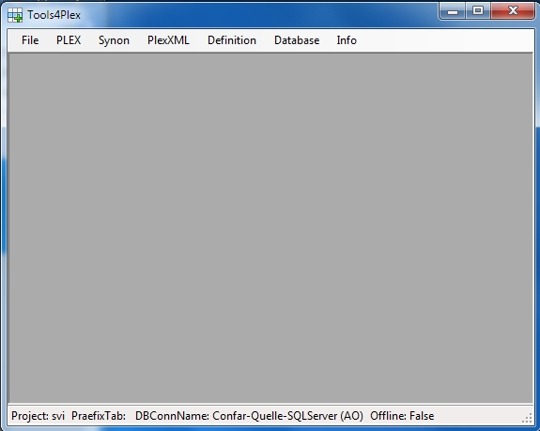
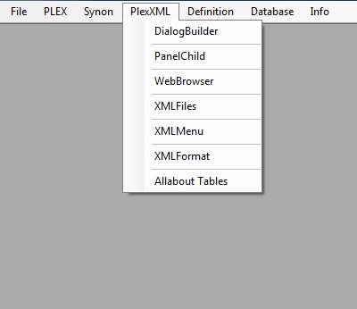
Moving from CA 2E to CA Plex…
A productivity tool for CA Plex
PlexXML is one View framework that we use.
  Tools4Plex assists in creating the files necessary to generate the possible PlexXML dialogs
the user interface
diverse functionality
View controls
(buttons, links, …)

Slide 17
Positioning Tools4Plex
Development process:
Datamodel design
Build the datamodel (inside CA Plex)
  Entities, Views & Indexes
  Fields, Labels & Values
  Relations
  ….
Analyse the functional groups, determine inheritance
Define and create the inheritance triples
Develop functionality
time passes, new requirements, new systems,….
Refactoring and migration
  Tools4Plex
  Tools4Plex
  Tools4Plex
  Tools4Plex
  Tools4Plex
  Tools4Plex

Slide 18
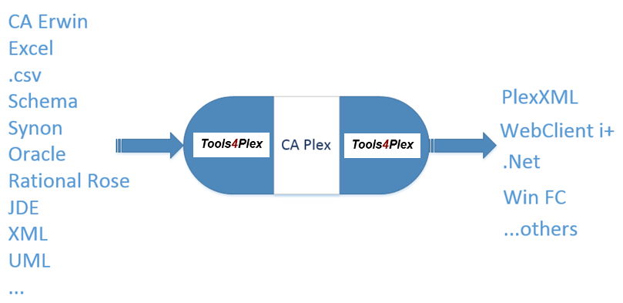


Positioning Tools4Plex
  The quintessence of Tools4Plex

Slide 19
Positioning Tools4Plex
  Mass modeling
add multiple triples
change multiple triples
name refactoring
language translation
model translation

Slide 20
Different parts of Tools4Plex
PlexBox
  Rock around a Plex model
PlexXMLBox
  Rock around PlexXML integration
SynonViewer
  Insight a Synon model
PreView what we are workig on
  PlexBox – „full“ Synon AD import
  PlexXMLBox – more complex dialogs and charts
Notes:
20

Slide 21
About Tools4Plex…
A productivity tool for CA Plex
The story behind the tool
What do we have right now
Where do we want to go

Slide 22
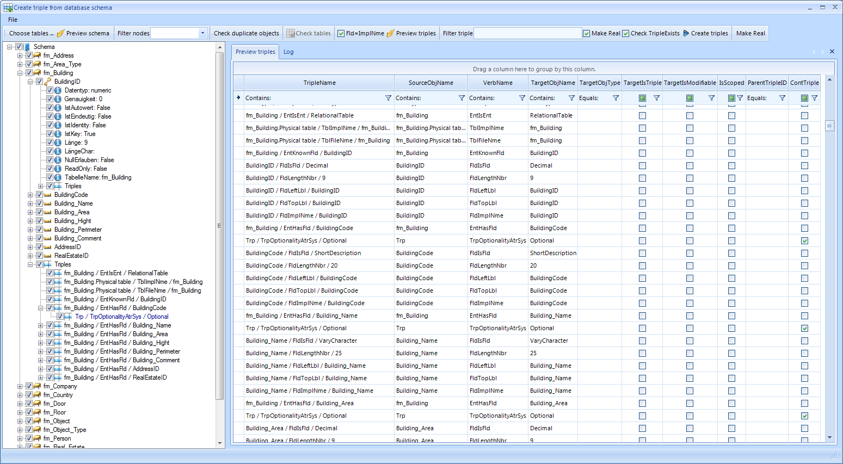
Main processes ➔ Menu PLEX ➔ Create triples from Schema
Different aspects of Tools4Plex
Schema selection and preview of triples to generate
Notes:
Linke Seite: Baumansicht mit allen Tabellen, Feldern, Feldeigenschaften und eine Kurzansicht der Triples
Rechte Seite: Tabellarische Ansicht aller zu erstellenden Triples
22

Slide 23
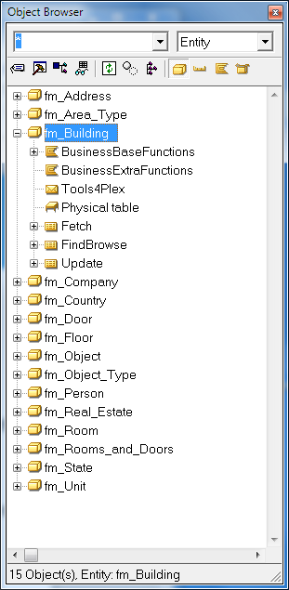
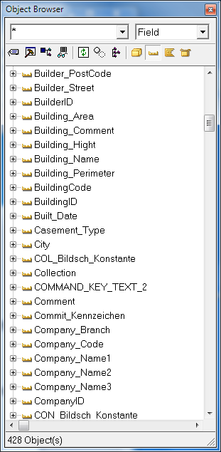
Main processes ➔ Menu PLEX ➔ Creating triples
Different aspects of Tools4Plex
Results in CA Plex
ObjectBrowser
All objects made real.
Fields inherit from the required base fields.
Notes:
Links: Ansicht der erstellten Tabellen im Object Browser
Rechts: Ansicht der erstellten Felder im Object Browser
23

Slide 24
About Tools4Plex…
To get this done fast and with high quality, you need some automation.
You need
Or 24 hours a day + the night

Slide 25
About Tools4Plex…
Regardless whether it's
a new project or
modernization or
simply refactoring,
whether it's
with Synon, with CA Plex or native,
the time required is often too long and worst of all "there's some boring work"...for the developer.

Slide 26
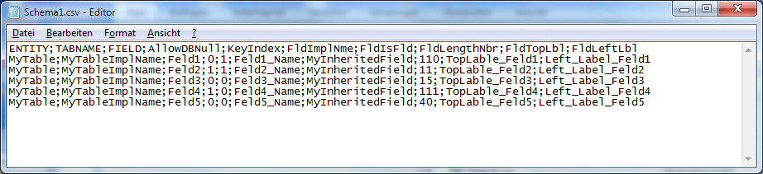
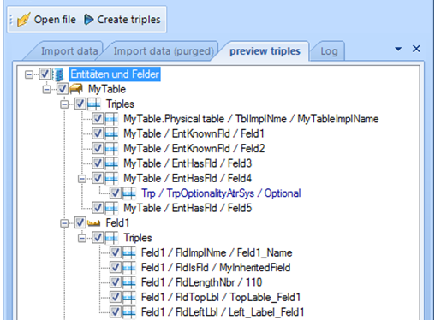
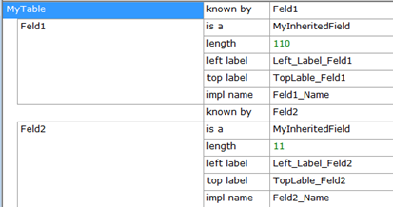
Different aspects of Tools4Plex
Main processes ➔ Menu PLEX ➔ .csv-import
Example: import of a db-schema in .csv-format
Notes:
Neue Funktion: Import Triples
Vorgaben für das Datenmodell von der Businessanalyse, die maschinell verarbeitet werden können, liefern die Basis für die Erstellung des Datenmodells in CA Plex.
Wenn man das weiterspinnt, könnte man sogar Vorgaben der Verarbeitungslogik in ActionDiagram-Code umwandeln. Und das vollautomatisch.
26

Slide 27
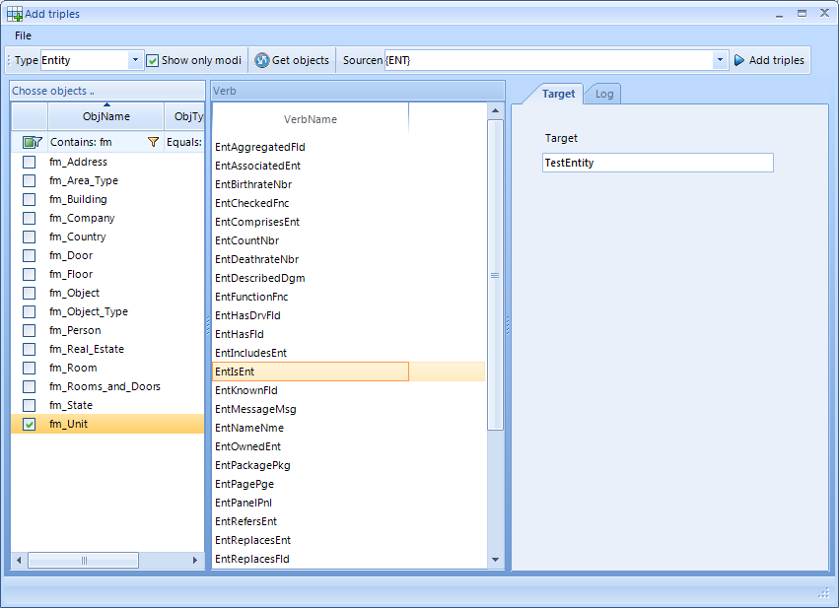
Main processes ➔ Menu PLEX ➔ Add triples
Different aspects of Tools4Plex
Depending on the selected objects and verb names, new triples are created.
Example:
EntIsEnt
DEMO
Notes:
Linke Seite: Baumansicht mit allen Tabellen, Feldern, Feldeigenschaften und eine Kurzansicht der Triples
Rechte Seite: Tabellarische Ansicht aller zu erstellenden Triples
27

Slide 28
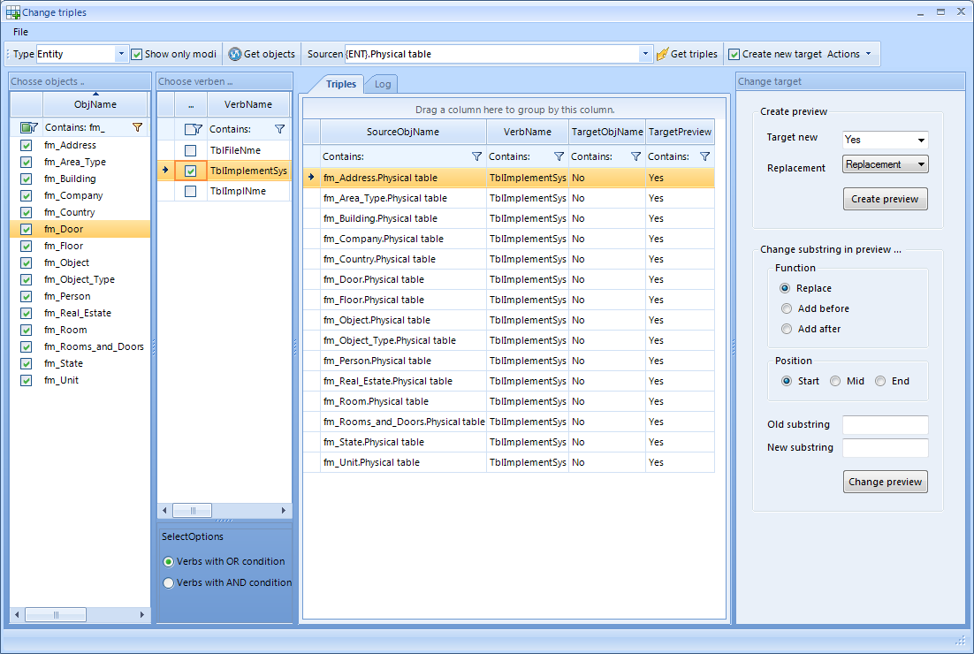
Hauptfunktionen ➔ Die PlexBox ➔ Create triples (Templates)
Different aspects of Tools4Plex
Main processes ➔ Menu PLEX ➔ Change triples
Notes:
Links: Sicht auf die Entities im Plex Model
Rechts: Sicht auf die definierten Triples, die für jede Entität erstellt werden sollen. {ENT} ist hierbei ein Platzhalter, für den der jeweilige Entityname eingesetzt wird.
Unterteilung in Triples für das Application Model (App) und das Web Model (Web). Zur Unterstützung der Entwickler sind hier optische Merker eingebaut worden, die auf einen nötigen Wechsel in das Web Model hinweisen. Dies ist aber optional.
Die Triples werden automatisch auf „Real“ gesetzt
28

Slide 29
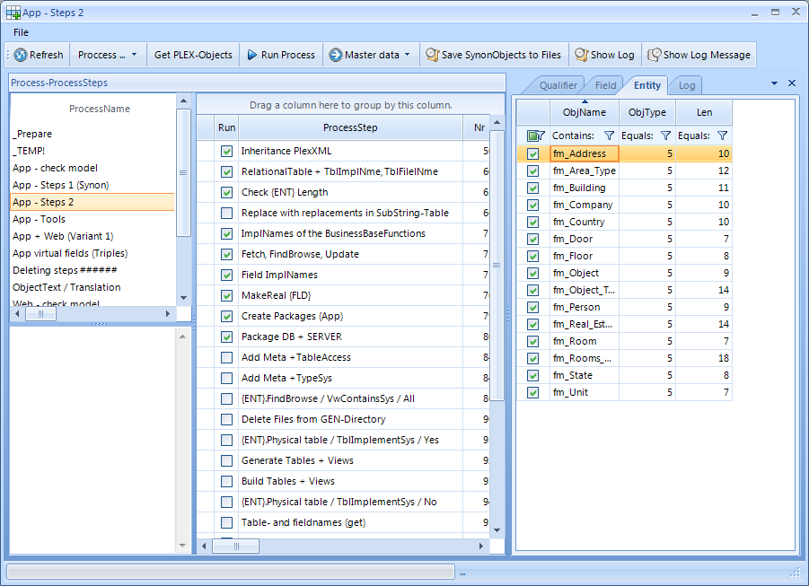
Hauptfunktionen ➔ Die PlexBox ➔ Create triples (Templates)
Different aspects of Tools4Plex
Main processes ➔ Menu PLEX ➔ Process
What was just shown, can be packaged into process-steps (which can contain triple templates) and executed against selected objects.
Notes:
29

Slide 30
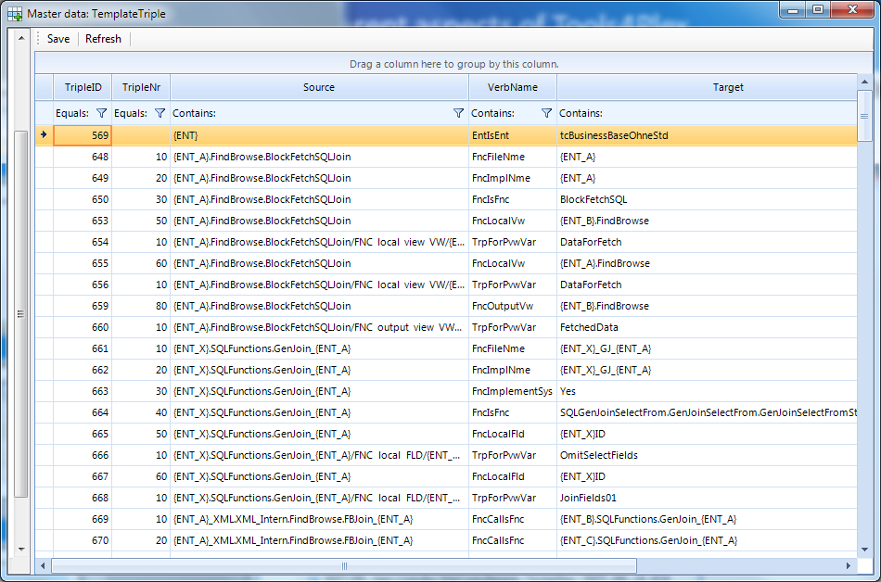
Hauptfunktionen ➔ Die PlexBox ➔ Create triples (Templates)
Different aspects of Tools4Plex
Main processes ➔ Menu PLEX ➔ Template triples
View of predefined triple-templates
Notes:
Links: Sicht auf die Entities im Plex Model
Rechts: Sicht auf die definierten Triples, die für jede Entität erstellt werden sollen. {ENT} ist hierbei ein Platzhalter, für den der jeweilige Entityname eingesetzt wird.
Unterteilung in Triples für das Application Model (App) und das Web Model (Web). Zur Unterstützung der Entwickler sind hier optische Merker eingebaut worden, die auf einen nötigen Wechsel in das Web Model hinweisen. Dies ist aber optional.
Die Triples werden automatisch auf „Real“ gesetzt
30

Slide 31
Hauptfunktionen ➔ Die PlexBox ➔ Create triples (Templates)
Different aspects of Tools4Plex
Main processes ➔ Menu PLEX ➔ Process
Additional process-steps can be added that execute things like:
Delete files from GEN-directory
Generate and Build operations
Groupmodel operations
Tools4Plex-database operations
Check future length of automatically generated implnames and filenames
…
DEMO
Notes:
31

Slide 32
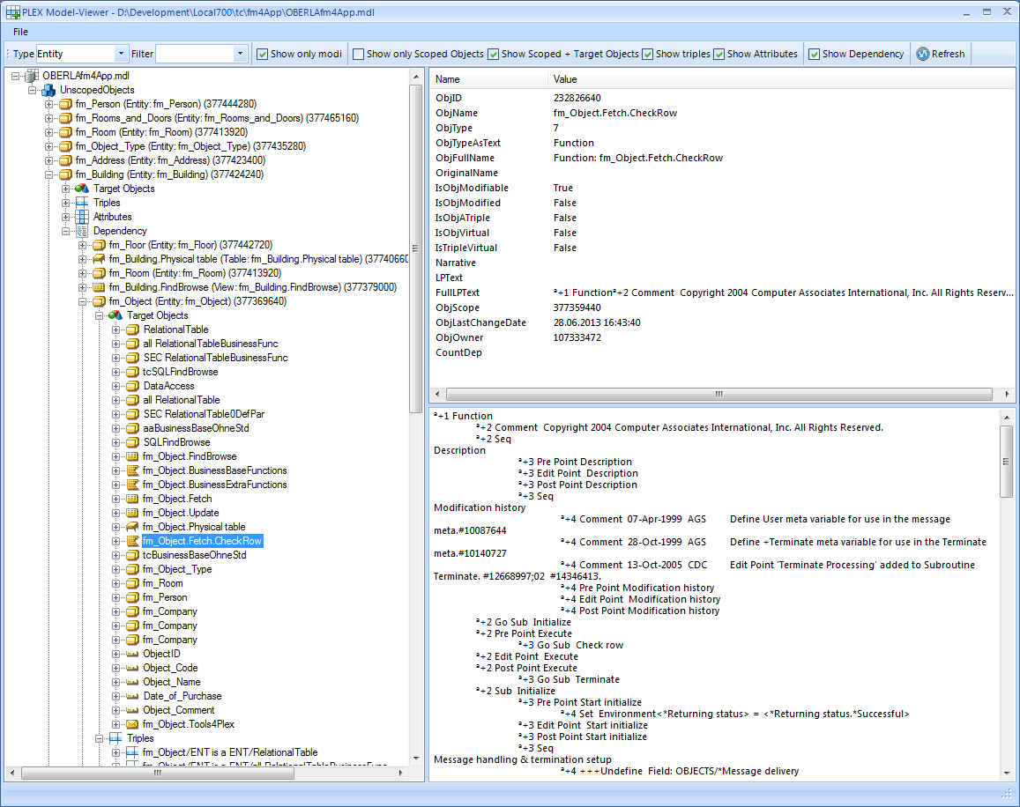
Hauptfunktionen ➔ Die PlexBox ➔ Create triples (Templates)
Different aspects of Tools4Plex
Main processes ➔ Menu PLEX ➔ ModelViewer
Left (TreeView)
Explore all types of objects with its target objects, triples, attributes and dependencies
Right (Details)
ObjectProperties
ActionDiagram if available
DEMO?
Notes:
32

Slide 33
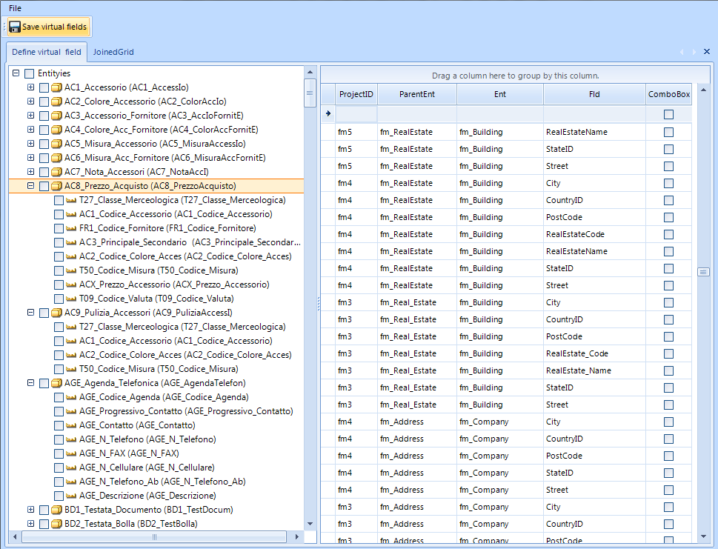
Hauptfunktionen ➔ Die PlexBox ➔ Create triples (Templates)
Different aspects of Tools4Plex
Main processes ➔ Menu PLEX ➔ Define virtual fields
Left (TreeView)
All entities with all their attributes, to define the fields that can act as virtual fields, when not defined in your model.
This is required for the PlexXML UI
Notes:
33

Slide 34
Hauptfunktionen ➔ Die PlexBox ➔ Create triples (Templates)
Different aspects of Tools4Plex
Main processes ➔ Menu PLEX
End of Part 1
Need more?
Notes:
34

Slide 35
Hauptfunktionen ➔ Die PlexXMLBox
Different aspects of Tools4Plex
Main processes ➔ Menu PlexXML
PlexXML DialogBuilder
  Create and store browserbased standardpanels for the administration of all the tables in a breath.
  Tabular view (Grid)
  Detailpanel with editing functionality
  combined tabular and detail panels
  MasterDetail and MasterTab
PanelChildBuilder
  Definition of more complex dialogs by combining existing panels.
Notes:
35

Slide 36
PlexXML… the beginning
Different aspects of Tools4Plex
Who knows PlexXML?
Who uses PlexXML?
What is PlexXML?
A dynamic CA Plex web client using XML and Ajax
I began with PlexXML in 2009 and had quick success with the tutorial, however...
PlexXML relies heavily on Java/xsl/xslt technology, which I don’t know that well, being a tool person.
“Anything difficult to do manually, should be automated”
Tools4Plex for PlexXML was born
Following the development of Tools4Plex for PlexXML, most of the steps necessary to get the PlexXML based UI and functionality up and running was automated (2011/2012)

Slide 37
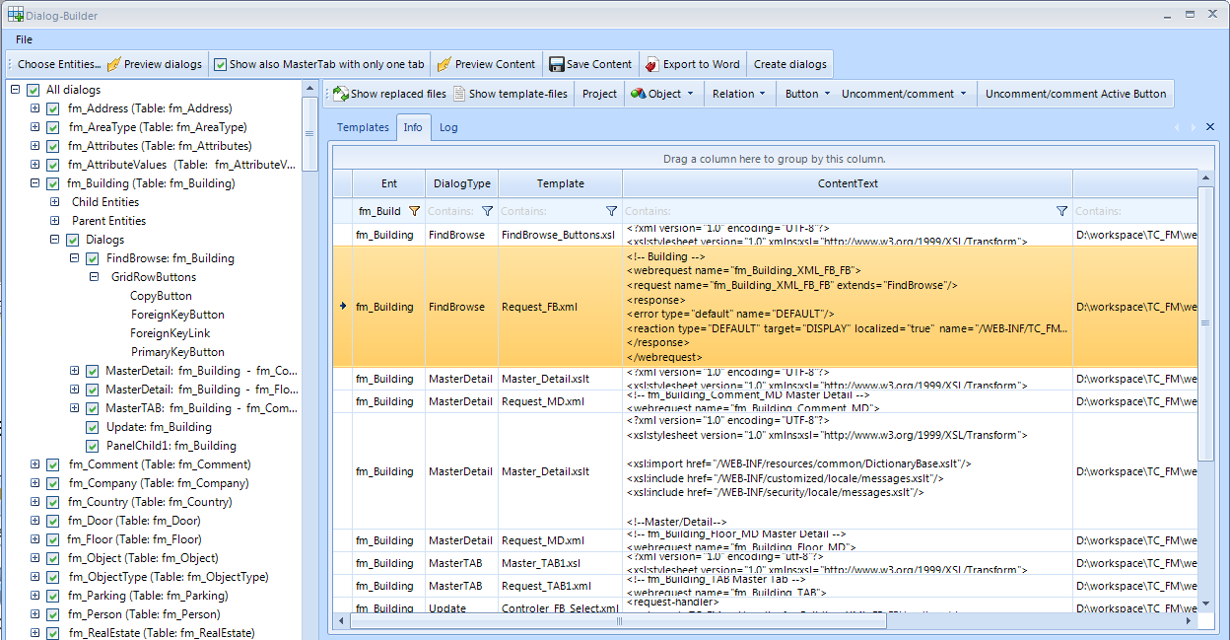
Different aspects of Tools4Plex
Main processes ➔ Menu PlexXML ➔ DialogBuilder
Notes:
Nach Auswahl der Entities, kann eine Vorschau (Baumansicht) der möglichen Dialoge angezeigt werden
Preview Content (rechts)
Vorschau der XML-Daten, auf Basis vordefinierter Templates. Platzhalter sind bereits durch die jeweiligen Namen auf Basis der ausgewählten Entitäten ersetzt.
In der Spalte „Template“ ist die XML-/XSL-Datei zu sehen, für die der Code bestimmt ist
Ganz rechts der Pfad, im Eclipse-workspace, in dem die Dateien gespeichert werden.
37

Slide 38
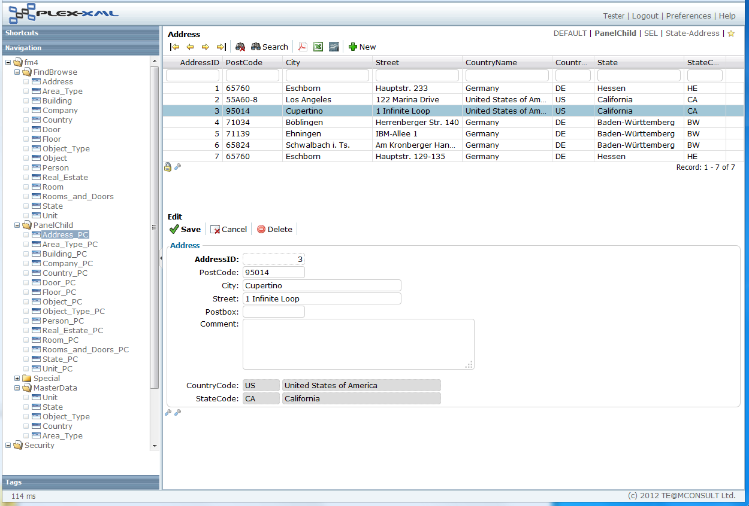
Different aspects of Tools4Plex
Main processes ➔ Menu PlexXML ➔ DialogBuilder
PanelChild dialog
Notes:
Kombinierte Ansicht aus einem Grid und der Bearbeitungsansicht aus der letzten Folie.
Keine Mehrfacherstellung, sondern Nutzung vorhandener Bausteine.
38

Slide 39
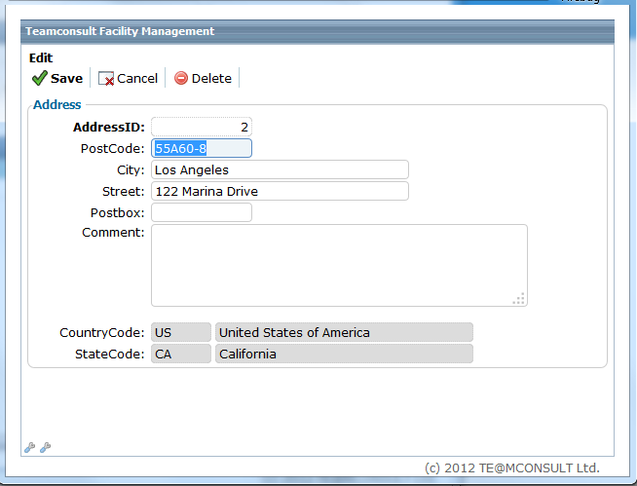
Different aspects of Tools4Plex
Main processes ➔ Menu PlexXML ➔ DialogBuilder
Detail view with editing functionality
Notes:
39

Slide 40
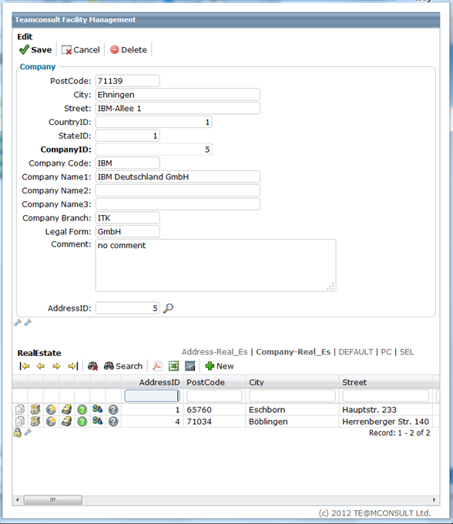
Different aspects of Tools4Plex
Main processes
Menu PlexXML
DialogBuilder
  MasterDetail
  Dialog
Notes:
40

Slide 41
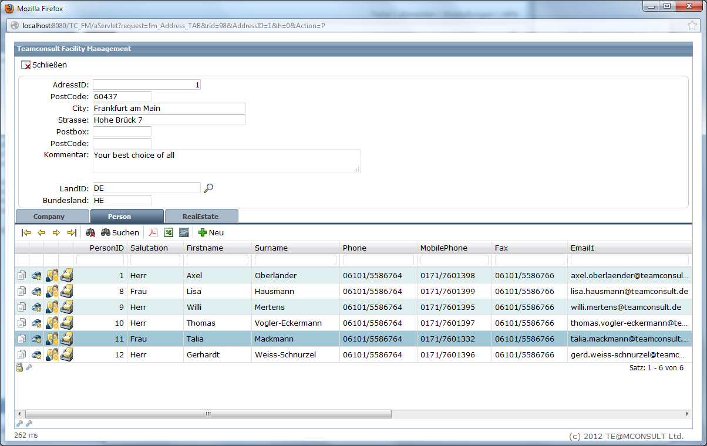
Hauptfunktionen ➔ Die PlexXMLBox ➔ DialogBuilder
Different aspects of Tools4Plex
Main processes ➔ Menu PlexXML ➔ DialogBuilder
  MasterTab Dialog
Notes:
Letztes Beispiel
41

Slide 42
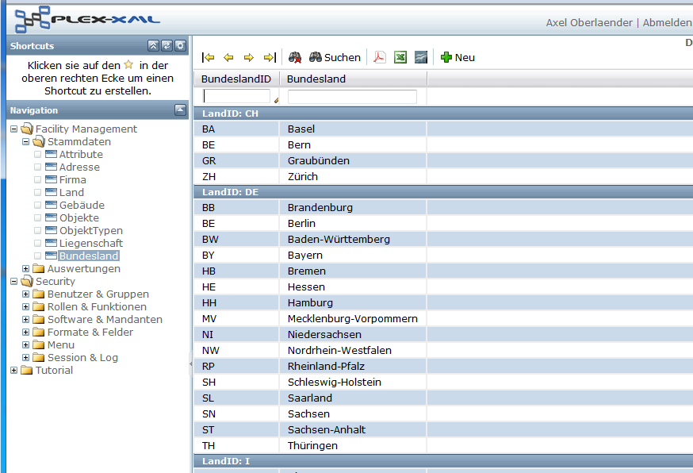
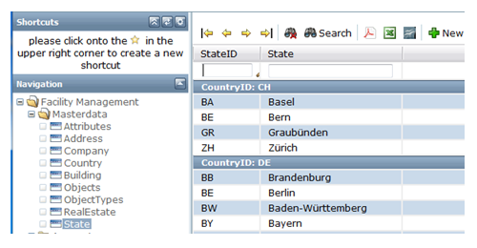
PlexXML offers multi language support easily
All text elements in a panel can be shown in different languages, as long as they were found in the dictionary.
This depends on the user that is logged in and the language selected for him.
Notes:
42

Slide 43
Hauptfunktionen ➔ Die PlexXMLBox
Different aspects of Tools4Plex
Main processes ➔ Menu PlexXML ➔ DialogBuilder
DEMO
Notes:
43

Slide 44
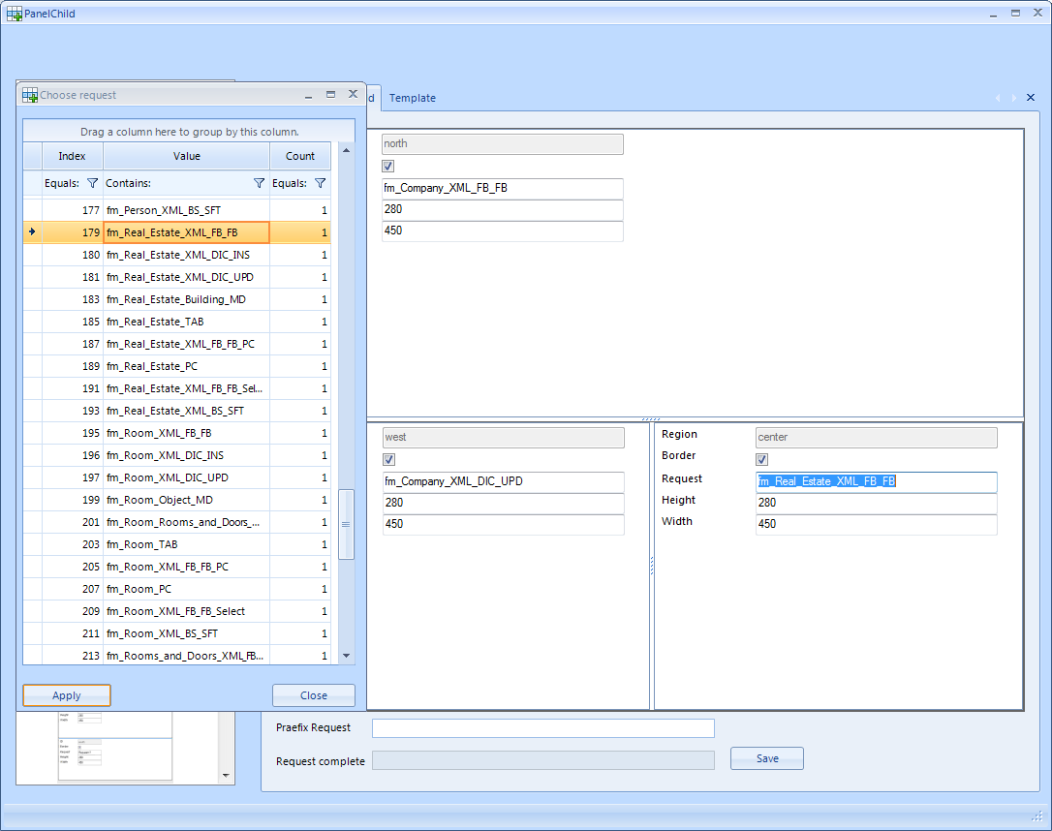
Hauptfunktionen ➔ Die PlexXMLBox
Different aspects of Tools4Plex
Main processes ➔ Menu PlexXML ➔ PanelChild
Combine existing dialogs to get a new and powerful PanelChild dialog…
Notes:
44

Slide 45
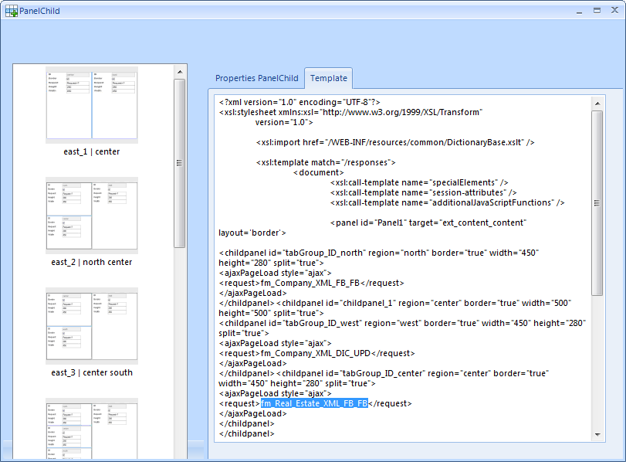
Hauptfunktionen ➔ Die PlexXMLBox
Different aspects of Tools4Plex
Main processes ➔ Menu PlexXML ➔ PanelChild
…and let Tools4Plex generate the necessary code
Notes:
45

Slide 46
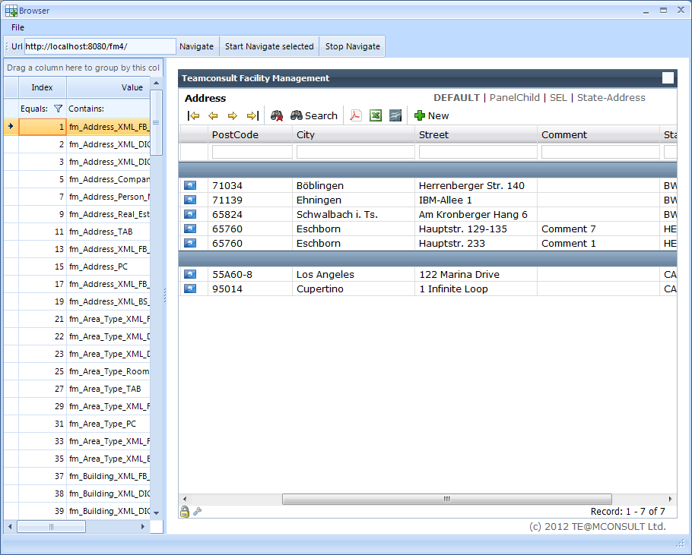
Hauptfunktionen ➔ Die PlexXMLBox
Different aspects of Tools4Plex
Main processes ➔ Menu PlexXML ➔ Webbrowser
Automatic navigation to every generated request. of your application, to get the information written into PlexXML-database !!
Notes:
46

Slide 47
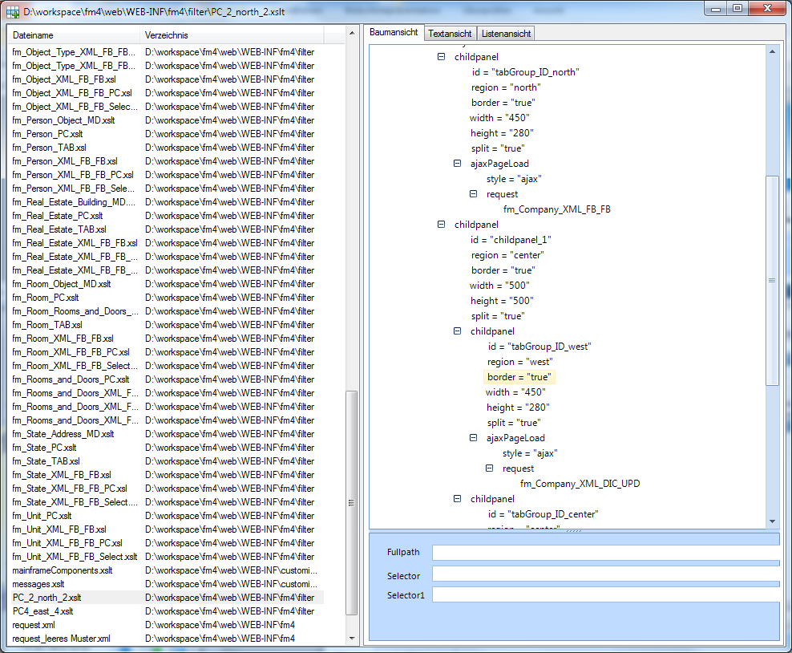
Hauptfunktionen ➔ Die PlexXMLBox
Different aspects of Tools4Plex
Main processes ➔ Menu PlexXML ➔ XMLfiles
Browse through all of the generated xml, xsl/xslt-files and the code contained
Notes:
47

Slide 48
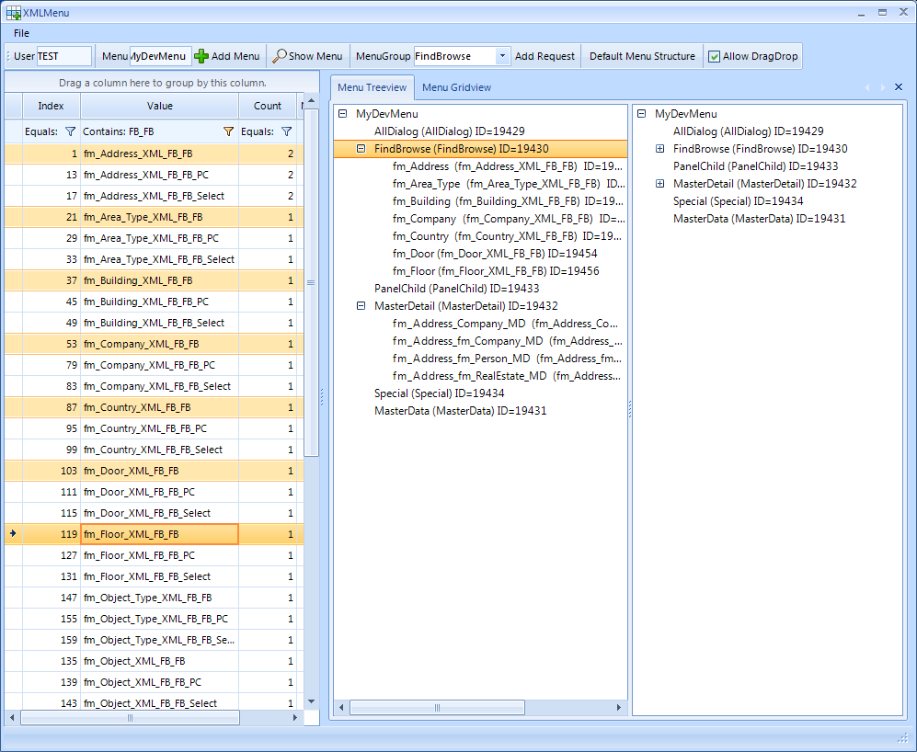
Hauptfunktionen ➔ Die PlexXMLBox
Different aspects of Tools4Plex
Main processes ➔ Menu PlexXML ➔ XMLMenu
Create all the menus needed to test your functions…with one click.
When ready, drag `n drop the menu items to their respective menus.
Notes:
48

Slide 49
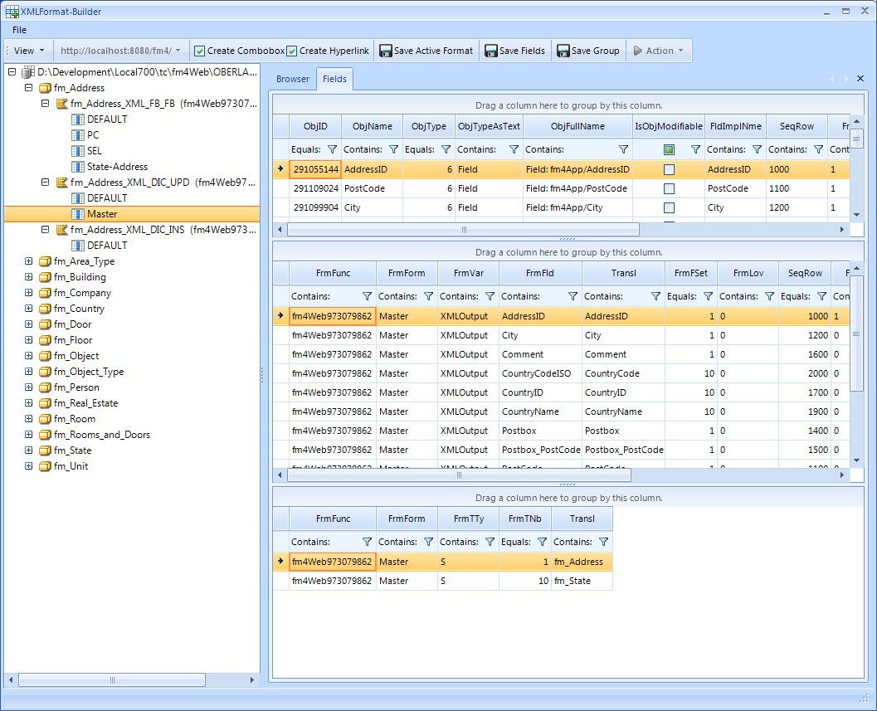
Hauptfunktionen ➔ Die PlexXMLBox
Different aspects of Tools4Plex
Main processes ➔ Menu PlexXML ➔ XMLFormat
View on generated functions and formats.
Create combo boxes and/or the hyperlinks you want within the formats.
Notes:
49

Slide 50
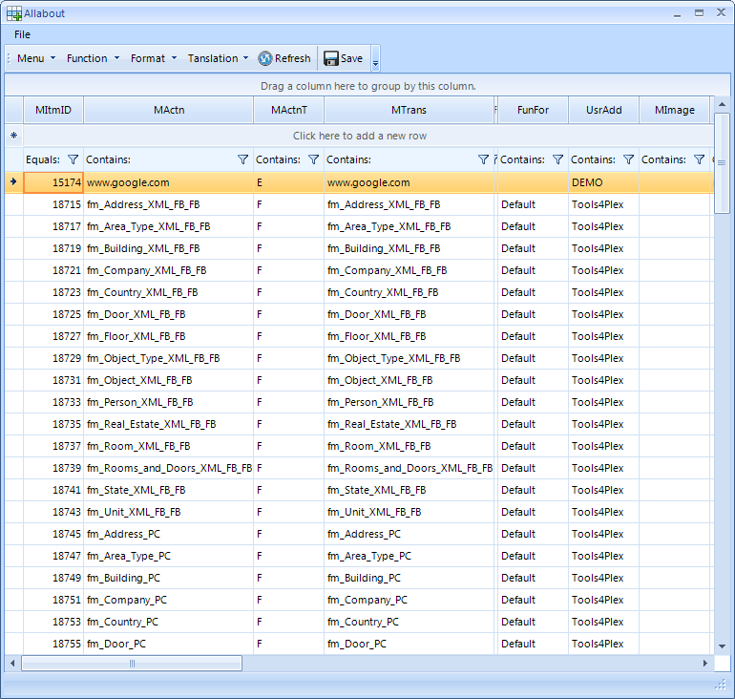
Hauptfunktionen ➔ Die PlexXMLBox
Different aspects of Tools4Plex
Main processes ➔ Menu PlexXML ➔ XMLAllabout
Central view of PlexXML tables that define your menus, functions, formats and translations.
For example:
Here the menu tab is active, so the menu items created by Tools4Plex can be seen
Notes:
50

Slide 51
About Tools4Plex…
A productivity tool for CA Plex
The story behind the tool
An example in numbers
What do we have right now
Where do we want to go

Slide 52
Where do we want to go?
About Tools4Plex…
Continued integration of further presentation layers.
Who wants to be first?
Notes:
52

Slide 53
Moving from CA 2E to CA Plex…
Thank you for your patience
Notes:
53

Slide 54
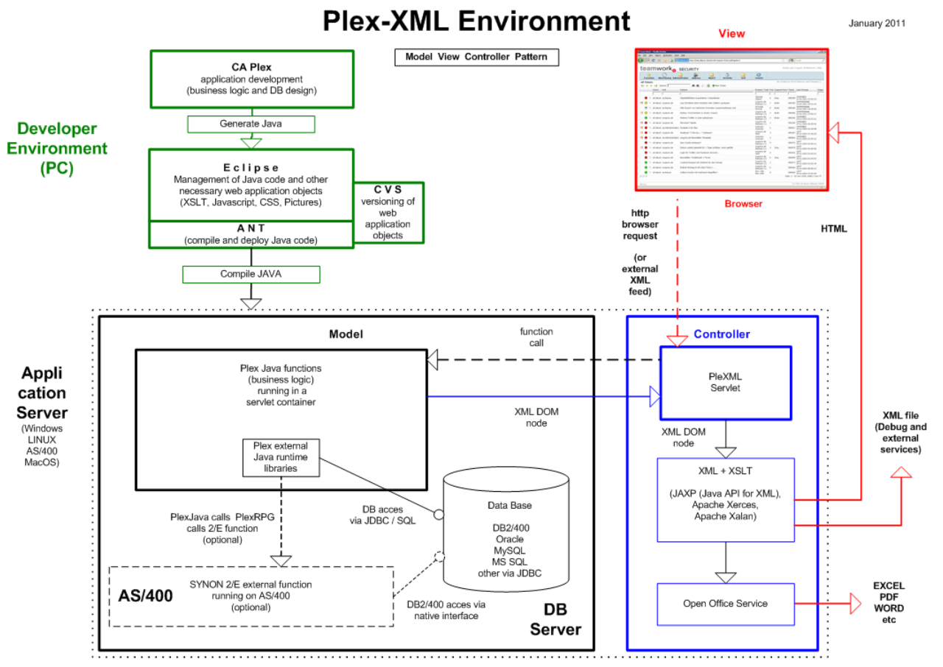
Vorschau nächstes Release
About Tools4Plex…
Thank you for your interest.
Any questions? Anytime!
Notes:
54

Slide 55











Possible platforms
Web Server
Application Server
DB Server
Datenbanken
Web Services
ASP .NET
WPF clients
DDS
SQL
Plex Desktop Clients
Java, MFC
RPG
JDBC
C#
OLE DB
SQL
WebClient i+ Java, Ajax, Web 2.0, Html5, Mobile…
Native
.Net
PlexXML Framework WebClient, WebServices, SOA, Ajax, Web 2.0, Html5, Mobile…
Socks4-SecurityLayer, User-Administration and authorisation on menus, functions, fields and data
IBM System i
WinServer 2008 R2
Sun OS, Linux
SQL

Slide 56
TE@MCONSULT Group
Speakers Bio
Name: Axel Oberländer
Developer: since 1983
CA 2E: since 1988
CA Plex: since 1995 (Obsydian r1.02)
Club Lava Member#: 32
Mail: axel.oberlaender@teamconsult.de
URL: www.teamconsult.de/tsd
Co-Speakers Bio
Name: James D. Ryan
Developer: since 1981
CA 2E: since 1987
CA Plex: since 1995 (Obsydian r1.02)
Employees TSD(Group)
6+(30)
3(12) Development
2(4) Consulting and Services
1(3) Marketing and Sales
1(3) Backoffice
5(8) External Contractors
Company
TE@MCONSULT Ltd.
Solutions & Development
Hohe Brück 7
60437 Frankfurt am Main
TE@MCONSULT Solutions & People Ltd.
Steinhauserstrasse 160
42399 Wuppertal
TE@MCONSULT Sales Force Ltd.
Steinhauserstrasse 160A
42399 Wuppertal
Partners
5 in D, CH and I
Customers
> 70 companies / organisations, in D-I-CH

